Slide 1

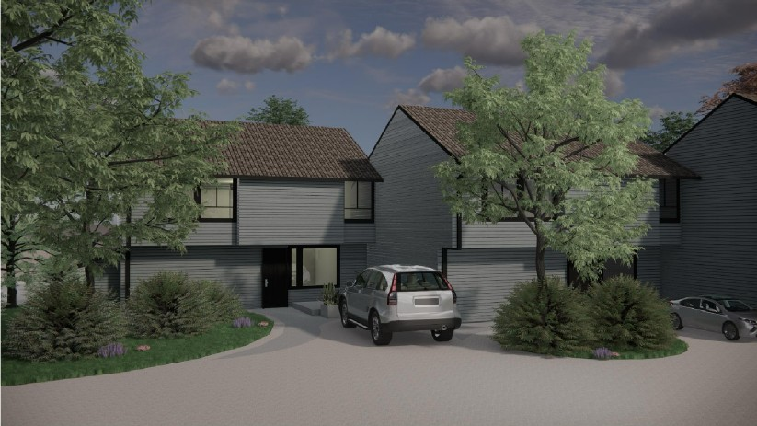
Adanac Housing
Restruction Building Services Ltd.
Sense Engineering
Highbury West Development

Slide 2



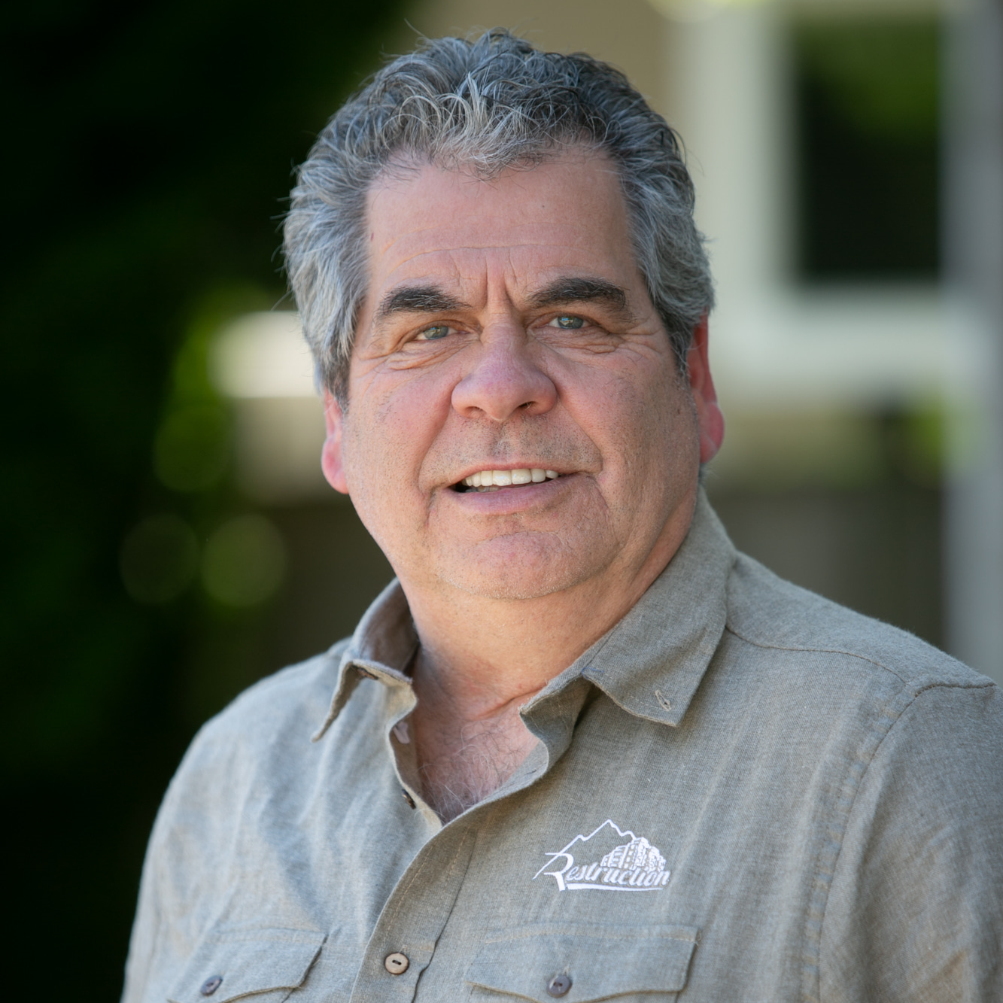

Restruction Building Services
Our Team
0
02
03
04
Hayden Gallacher,
B. Tech-CM
Principal
BCIT Construction
Management Degree
Joined RBS since in 2008
Graham DeClerq DipFin
Senior Project Manager
BCIT Diploma of Finance
Joined RBS Since in 2024
Dennis Williams,
Carpentry Red Seal
General Operations Manager
BCIT Carpentry Red Seal
Joined RBS since in 1998
Nariman Pour aliakbar
Project Manager M.S.C.E
Joined RBS since in 2022

Slide 3


Restruction Building Services
Our Team
`````
02
03
Cameron Chersak
Superintendent
Red Seal Carpenter
Joined RBS since in 2023
Isaac Botello
Superintendent
Red Seal Carpenter
Joined RBS since in 2022

Slide 4
Project Scope
Mobilization
Scaffolding
Demolition
Rot Repair
Rough Carpentry
Vinyl Membrane
Window and Door delivery
Window and Door Installation
Mechanical
Electrical
Wall cladding
Flashing
Caulking
Railing installation
Interior Upgrades
Demobilization

Slide 5
Adanac Housing
Phase 1 Project Tasks
Scope of work | Not Started | On Going | Completed
Mobilization |  |  | X
Scaffolding |  | X
Demolition | X
Rot Repair | X
Rough Carpentry | X
Vinyl Membrane | X
Window & Door Delivery | X
Window & Door Installation | X
Mechanical | X
Electrical | X
Wall Cladding | X
Flashing | X
Caulking | X
Railing Installation | X
Interior Upgrades | X
Deficiencies | X
Demob | X

Slide 6
Adanac Housing
Phase 2 Project Tasks
Scope of work | Not Started | On Going | Completed
Mobilization | X
Scaffolding | X
Demolition | X
Rot Repair | X
Rough Carpentry | X
Vinyl Membrane | X
Window & Door Delivery | X
Window & Door Installation | X
Mechanical | X
Electrical | X
Wall Cladding | X
Flashing | X
Caulking | X
Railing Installation | X
Interior Upgrades | X
Deficiencies | X
Demob | X

Slide 7
Adanac Housing
Phase 3 Project Tasks
Scope of work | Not Started | On Going | Completed
Mobilization | X
Scaffolding | X
Demolition | X
Rot Repair | X
Rough Carpentry | X
Vinyl Membrane | X
Window & Door Delivery | X
Window & Door Installation | X
Mechanical | X
Electrical | X
Wall Cladding | X
Flashing | X
Caulking | X
Railing Installation | X
Interior Upgrades | X
Deficiencies | X
Demob | X

Slide 8
Adanac Housing
Phase 4 Project Tasks
Scope of work | Not Started | On Going | Completed
Mobilization | X
Scaffolding | X
Demolition | X
Rot Repair | X
Rough Carpentry | X
Vinyl Membrane | X
Window & Door Delivery | X
Window & Door Installation | X
Mechanical | X
Electrical | X
Wall Cladding | X
Flashing | X
Caulking | X
Railing Installation | X
Interior Upgrades | X
Deficiencies | X
Demob | X

Slide 9
Adanac Housing
Phase 5 Project Tasks
Scope of work | Not Started | On Going | Completed
Mobilization | X
Scaffolding | X
Demolition | X
Rot Repair | X
Rough Carpentry | X
Vinyl Membrane | X
Window & Door Delivery | X
Window & Door Installation | X
Mechanical | X
Electrical | X
Wall Cladding | X
Flashing | X
Caulking | X
Railing Installation | X
Interior Upgrades | X
Deficiencies | X
Demob | X

Slide 10
Adanac Housing
Notices that will be sent to your door
Notices to expect | Links
1 - General Construction Notice | 1 - General Construction Notice.docx
2 - Access Notice - General | 2 - Access Notice - General.docx
3 - Elevator Shut Down | 3 - Elevator Shut Down.docx
4 - Window Measuring and Pre-construction Survey | 4 - Window Measuring and Pre-construction Survey.docx
5 - Drywall Abatement Cutting Work | 5 - Drywall Abatement Cutting Work.docx
6 - Mechanical & Electrical Survey (Per Unit Type) | 6 - Mechanical & Electrical Survey (Per Unit Type).docx
7 - Mechanical Electrical Penetrations - Heat Pumps | 7 - Mechanical Electrical Penetrations - Heat Pumps.docx
8 - Window and Sliding Door Installation | 8 - Window and Sliding Door Installation.docx
9 - Swing and Utility Door Installation | 9 - Swing and Utility Door Installation.docx
10 - Mechanical Rough-in - Heat Pump Equip & Fixture Replacement | 10 - Mechanical Rough-in - Heat Pump Equip & Fixture Replacement.docx
11 - Water Testing | 11 - Water Testing.docx
12 - Mechanical Fixture & Device Installation | 12 - Mechanical Fixture & Device Installation.docx
13 - Electrical Fixture & Device Installation | 13 - Electrical Fixture \u0026 Device Installation.docx
14 - Firestop Sealant Installation at Penetrations | 14 - Firestop Sealant Installation at Penetrations.docx

Slide 11
Adanac Housing
Notices that will be sent to your door
Notices to expect | Links
15 - Interior Drywall Repairs - Rot Repairs | 15 - Interior Drywall Repairs - Rot Repairs.docx
16 - Interior Drywall Repair Survey | 16 - Interior Drywall Repair Survey.docx
17 - Interior Drywall Repairs - Multi-Day Access | 17 - Interior Drywall Repairs - Multi-Day Access.docx
18 - Interior Trim Installations at Windows & Doors | 18 - Interior Trim Installations at Windows & Doors.docx
19 - Sealant & Painting (Interior Trims & Affected Walls & Ceilings) | 19 - Sealant & Painting (Interior Trims & Affected Walls & Ceilings).docx
20 - Interior Sign-off | 20 - Interior Sign-off.docx

Slide 12

QUESTIONS AND CONCERNS
Please Contact Your Building Liaison

